Slide 1
AMD Crossfire
DX11 Sample
Alex Kharlamov
Anas lasram

Slide 2
Table of contents
AMD Crossfire Driver Behavior
AMD Crossfire API
Crossfire DX11 Sample
Performance

Slide 3
AMD Crossfire Driver
Default Behavior

Slide 4
AMD Crossfire
Optimal Application frame submission on mULTI gpu systems
CPU
Frame n-2
Frame n-1
Frame n
Frame n+1
Frame n+2
Maximize frame rendering overlap between frames for best M-GPU scaling
GPU 0
Frame n-2
Frame n+1
GPU 1
Frame n-1
Frame n+2
GPU 2
Frame n
Frame n+3
Lost performance opportunity

Slide 5
Compatible-AFR transfer heuristics
Heuristic 1: A resource that is updated before it gets used within a frame is not stale
Heuristic 2: Let N be the number of GPUs in the system. A resource that is updated for N frames in a row before it gets used is not stale

Slide 6
AMD Crossfire: default behavior
If resource is not updated : transfers
Time that could have been used for the transfer
Shadow Update
Shadow Filtering
present
The only place where the driver can initialize a transfer is at present()
Frame N
GPU 0
Shadow Update
Shadow Filtering
present
Frame N+1
GPU 1
Application doesn’t update shadows on frame N+1
Application uses a resource that is “stale” driver needs to transfer if from a previous frame

Slide 7
AMD Crossfire: default behavior
If resource is Partially updated : corruption
Partial Shadow Update
Shadow Filtering
Frame N
present
GPU 0
Partial Shadow Update
Shadow Filtering
Frame N+1
present
GPU 1
Application performs a partial update on a resource.
Application uses a resource that is partially updated but partially “stale”. Driver has no way to tell the difference.

Slide 8
AMD Crossfire API

Slide 9
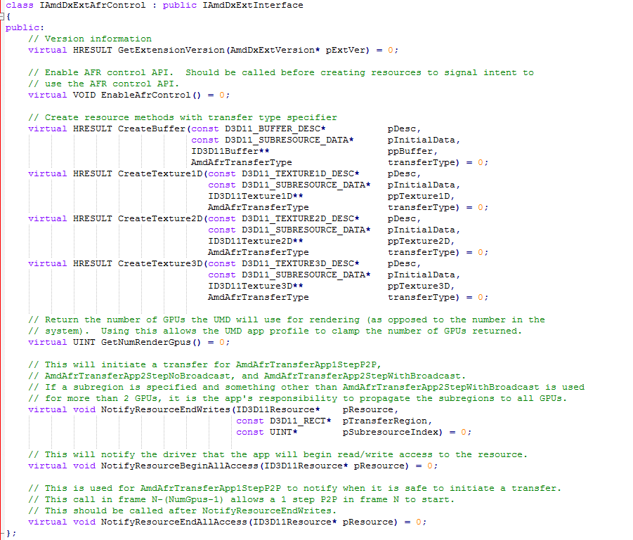
AMD Crossfire API
Driver extension headers
  Plain headers
  Application is responsible for loading driver DLLs and querying interfaces

Slide 10
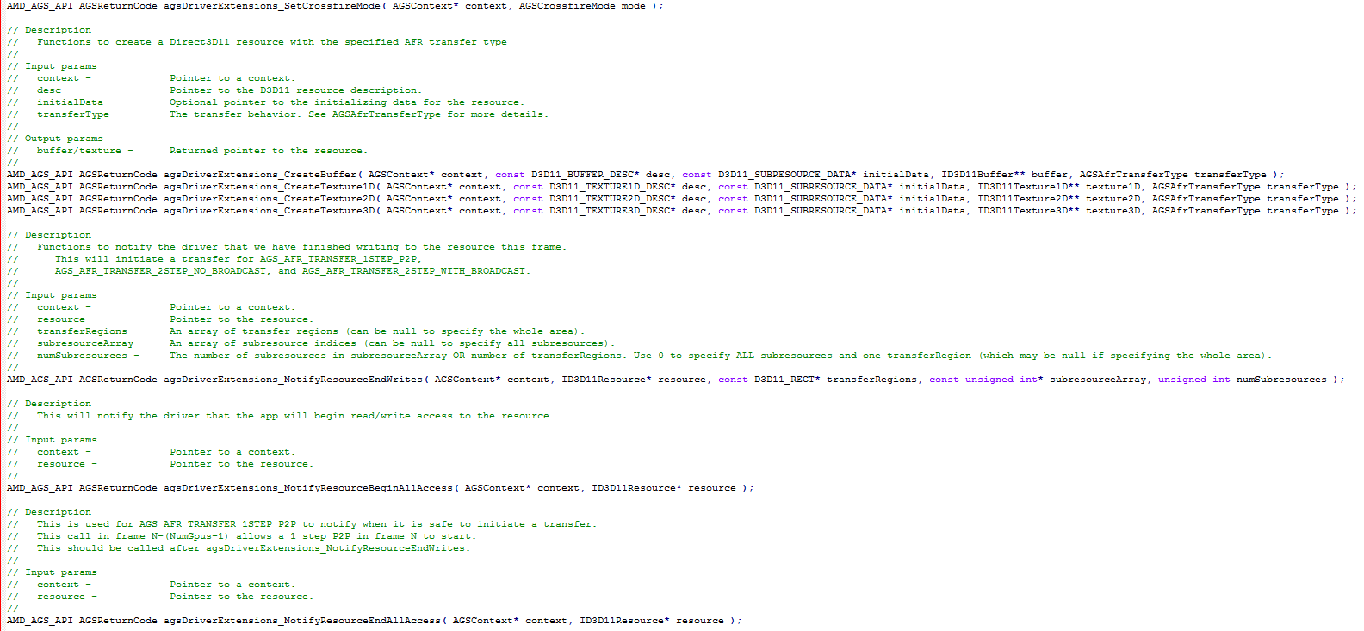
AMD Crossfire API
Samples use AGS library
AGS library
  ISV developed and maintained library
  Wraps multiple driver extensions

Slide 11
AMD Crossfire API
Resource Creation Flag | Description
DEFAULT | Behavior depends on Radeon Settings Crossfire mode
DISABLE | Turn off driver resource tracking
1STEP_P2P | app controlled GPU to next GPU transfer
2STEP_NO_BROADCAST | app controlled GPU to next GPU transfer using intermediate system memory
2STEP_WITH_BROADCAST | app controlled GPU to all render GPUs transfer using intermediate system memory
Radeon Settings CrossFire mode | Implicit control: The CrossFire API is not queried by the application | Explicit control: The CrossFire API is successfully queried by the application
Disabled | The application runs in single GPU mode | The CrossFire API cannot be queried. The application runs in single GPU mode
Default mode | If the application has a driver profile it will be used. If a driver profile does not exist the application will run in single GPU mode | If the application has a driver profile it will be used. If a driver profile does not exist, the CrossFire API cannot be queried and the application will run in single GPU mode
AFR friendly | The application runs in MGPU mode but resource tracking is disabled | Resource transfers are only applied when the application notifies the driver to do so. Resources created with the flag AFR_TRANSFER_DEFAULT or through the normal D3D11 API will not be tracked by the driver
Optimize 1x1 | The application runs in MGPU mode and resources will be tracked by the driver and will be rendered on each GPU if their resolution is 1x1 | Resource transfers are applied when the application notifies the driver to do so. Resources created with the flag AFR_TRANSFER_DEFAULT or through the normal D3D11 API will be tracked by the driver.Resources with dimensions of 1x1 will be rendered on each GPU.
AFR Compatible | The application runs in MGPU mode and resource tracking is enabled | Resource transfers are applied when the application notifies the driver to do so. Resources created with the flag AFR_TRANSFER_DEFAULT or through the normal D3D11 API will be tracked by the driver
Use AMD pre-defined profile | The mode allows using one of the existing driver profiles and applying it to the current application | The mode allows using one of the existing driver profiles and applying it to the current application

Slide 12
AMD Crossfire API
If resource is Partially updated
Signal BeginAllAccess()
Before the first use of a resource (read or write)
Signal EndWrite()
After the resource has been modified for the last time in the frame
Signal EndAllAccess()
After the resource has been used for the last time within a frame
Partial Shadow Update
Shadow Filtering
Frame N
present
GPU 0
Why 3 API calls for transfer API?..
Partial Shadow Update
Shadow Filtering
Frame N+1
GPU 1
present

Slide 13
AMD Crossfire API
If resource is Partially updated
Signal BeginAllAccess()
This will wait, for any incoming transfers from frame N-1
Signal EndWrite()
This will start transferring an updated resource from GPU 0 to GPU 1 for frame N+1
Signal EndAllAccess()
after the resource has been used for the last time within a frame
Partial Shadow Update
Shadow Filtering
Frame N
present
GPU 0
When should this transfer complete?..
Partial Shadow Update
Shadow Filtering
Frame N+1
present
GPU 1
Signal BeginAllAccess()
This will wait, for any incoming transfers from frame N
Signal EndWrite()
This will start transferring an updated resource from GPU 1 to GPU 0 for frame N+2
Signal EndAllAccess()
After the resource has been used for the last time within a frame

Slide 14
AMD Crossfire API
If resource is Partially updated
Signal BeginAllAccess()
This will wait, for any incoming transfers from frame N-1
Signal EndWrite()
This will start transferring an updated resource from GPU 0 to GPU 1 for frame N+1
Signal EndAllAccess()
After the resource has been used for the last time within a frame
Partial Shadow Update
Shadow Filtering
Frame N
present
GPU 0
This will incorrectly update the shadow on frame N with results from frame N+1, before filtering happens
Partial Shadow Update
Shadow Filtering
Frame N+1
present
GPU 1
Signal BeginAllAccess()
This will wait, for any incoming transfers from frame N
Signal EndWrite()
This will start transferring an updated resource from GPU 1 to GPU 0 for frame N+2
Signal EndAllAccess()
After the resource has been used for the last time within a frame

Slide 15
AMD Crossfire API
If resource is Partially updated
Signal BeginAllAccess()
This will wait, for any incoming transfers from frame N-1
Signal EndWrite()
This will start transferring an updated resource from GPU 0 to GPU 1 for frame N+1
Signal EndAllAccess()
After the resource has been used for the last time within a frame
Partial Shadow Update
Shadow Filtering
Frame N
present
GPU 0
This would be even worse. The resource is updated while it’s used for filtering.
Partial Shadow Update
Shadow Filtering
Frame N+1
present
GPU 1
Signal BeginAllAccess()
This will wait, for any incoming transfers from frame N
Signal EndWrite()
This will start transferring an updated resource from GPU 1 to GPU 0 for frame N+2
Signal EndAllAccess()
After the resource has been used for the last time within a frame

Slide 16
AMD Crossfire API
If resource is Partially updated
Signal BeginAllAccess()
This will wait, for any incoming transfers from frame N-1
Signal EndWrite()
This will start transferring an updated resource from GPU 0 to GPU 1 for frame N+1
Signal EndAllAccess()
After the resource has been used for the last time within a frame
BeginAllAccess()
Partial Shadow Update
Shadow Filtering
Partial Shadow Update
Frame N
present
Frame N+2
GPU 0
Transfer should complete after the last use in frame N and before the first use in frame N+2 (marked by BeginAllAccess)
Partial Shadow Update
Shadow Filtering
Frame N+1
present
GPU 1
Signal BeginAllAccess()
This will wait, for any incoming transfers from frame N
Signal EndWrite()
This will start transferring an updated resource from GPU 1 to GPU 0 for frame N+2
Signal EndAllAccess()
After the resource has been used for the last time within a frame

Slide 17
AMD Crossfire API
EndWrite – starts a transfer
  This is optional, if a resource isn’t updated within a frame don’t initiate transfers
BeginAllAccess – waits on any previous transfers to complete
EndAllAccess – gates any incoming transfers until resource can be safely updated
Time to perform a resource transfer is from EndAllAccess until the next BeginAllAccess
  >= (from Present until next BeginAllAccess)
  EndAllAccess can be naively called at Present()
  If EndAllAccess is placed as early as the engine allows this maximizes available time for transfer

Slide 18
AMD Crossfire API
TRANSFER_2STEP_GPU
Transfer API has a clear dependency on how the resource is used
  2 STEP GPU TRANSFER is an optimization that allows to remove dependencies
  Also simplifies CFX API integration
General idea:
  Given a resource that is updated irregularly
    it is referred to as the “Original” resource
  Create “Original” resource with DISABLE transfer flag
  Create a copy of that resource (same format and size) with applicable transfer flag (1STEP, 2STEP or 2STEP_BROADCAST)
    It is referred to as the “Transferred” resource
  On frame N when “Original” needs to be updated:
    BeginAllAccess(“Transferred”) → if there were any updates from previous frames, wait for them
    Copy(“Original”, Transferred”) → if there were any updates from previous frames, they need to be copied into “Original” now
    Update(“Original”)
    Copy(“Transferred”, “Original”) → whatever was updated in “Original” needs to be copied into “Transferred”
    EndWrites(“Transferred”) → “Transferred” is the resource we pass around
    EndAllAccess(“Transferred”) → Because we know “Transferred” will not be used throughout the frame we are done with it!
This is not an API flag, it’s implemented directly in SW and uses an applicable API flag

Slide 19
AMD Crossfire API
TRANSFER_2STEP_GPU
BeginAllAccess(Transfer);
Copy(Original, Transfer);
Copy(Transfer, Original) EndWrite(Transfer)
EndAllAccess(Transfer)
Shadow Update (Original)
Shadow Filtering (Original)
Frame N
present
GPU 0
Maximizes the time available for transfer
Shadow Update (Original)
Shadow Filtering (Original)
Frame N+1
present
GPU 1
BeginAllAccess(Transfer);
Copy(Original, Transfer);
Copy(Transfer, Original) EndWrite(Transfer)
EndAllAccess(Transfer)

Slide 20
Crossfire DX11 Sample

Slide 21
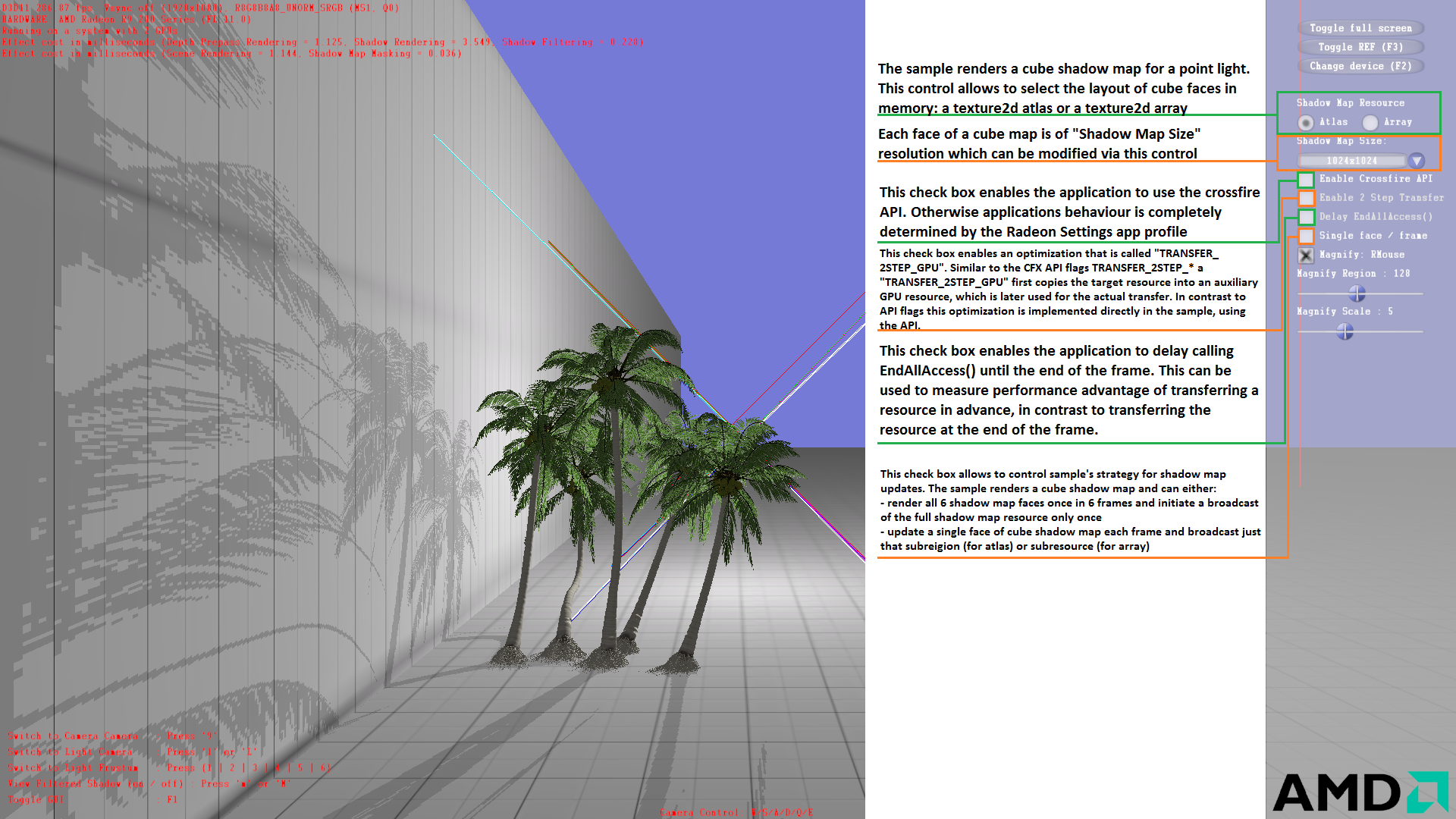
Crossfire DX11 Sample
UI
Notes:
This check box enables an optimization that is called "TRANSFER_2STEP_GPU". Similar to the CFX API flags TRANSFER_2STEP_* a "TRANSFER_2STEP_GPU" first copies the target resource into an auxiliary GPU resource, which is later used for the actual transfer. In contrast to API flags this optimization is implemented directly in the sample, using the API.
This check box enables the application to delay calling EndAllAccess() until the end of the frame. This can be used to measure performance advantage of transferring a resource in advance, in contrast to transferring the resource at the end of the frame.
This check box allows to control sample's strategy for shadow map updates. The sample renders a cube shadow map and can either:
- render all 6 shadow map faces once in 6 frames and initiate a broadcast of the full shadow map resource only once
- update a single face of cube shadow map each frame and broadcast just that subreigion (for atlas) or subresource (for array)

Slide 22
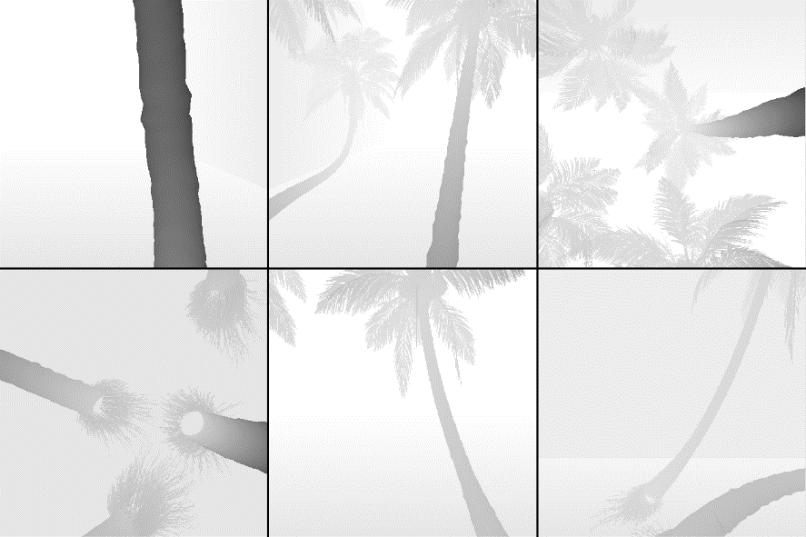


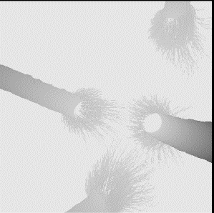


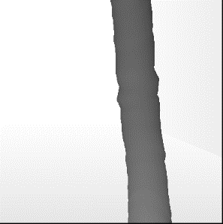
Crossfire DX11 Sample
UI
Texture2D Atlas Layout
Sample renders a cube shadow map for a point light
  A total of 6 shadow faces
“Shadow Map Size” controls the size of a single cube face
  So 1024² really means 6x1024²
Shadow map layout
  A 2D texture atlas
  A 2D texture array, each cube face located in a separate array slice
Shadow map updating schemes
  Update all 6 shadow faces once in 6 frames
    Frame I where (I % 6) == 0 renders more geometry and is slower
    Frame I where (I % 6) == 0 broadcasts the full resource
  Update 1 shadow face each frame
    Each frame broadcasts a single sub-region (or a sub-resource) of the full resource
  On average, both updating schemes:
    render the same amount of geometry
    transfer the same amount of data
Shadow Map Size
Shadow Map Size
Texture2D Array Layout
Shadow Map Size
Shadow Map Size

Slide 23
Performance

Slide 24
Performance characteristics (2 Radeon R9 290X)
Foreword
Numeric values in the performance tables are FPS
Test Hardware
  Two Radeon R9 290X
  Core i5 3330
Expectations for default driver modes (when CFX API is not used):
  AFR-Friendly mode
    Flicker is expected for both shadow map update schemes
    This profile provides us with the Speed of Light (SOL) Crossfire performance
  AFR-Compatible mode
    Flicker is expected when 1 shadow face is updated each frame
      The driver fails to detect a stale resource. This is explained on slides 6-7
    This profile provides us with default Crossfire transfer performance
    Crossfire API transfer performance is expected to be higher because sample initiates transfers earlier
Crossfire API was tested with Radeon Settings Crossfire profile for the sample set to AFR-Friendly
  Crossfire API performance is expected to be : AFR-Friendly ≥ Crossfire API ≥* AFR-Compatible
    2-STEP-GPU-TRANSFER has overhead for resource copies
    * AFR-Compatible mode will be as fast as AFR-Friendly for shadow map update scheme {1 shadow face updated each frame) because the driver doesn’t detect a stale resource.

Slide 25
Performance characteristics
TRANSFER FLAG: 2STEP_WITH_BROADCAST
Texture2D Atlas (each subregion 512²) | Single GPU | AFR Friendly | AFR Compatible | Crossfire API | Crossfire API: 2-STEP-GPU TRANSFER | Crossfire API: Delay EndAllAccess | Crossfire API 2-STEP-GPU TRANSFER + Delay EndAllAccess
6 shadow maps / updates once every 6 frames | 274 | 352 Flicker | 294 | 298 | 318 | 294 | 298
1 shadow map updated every frame | 273 | 468 Flicker | 466 Flicker | 235 | 428 | 235 | 419
Texture2D Array (subresource 512²) | Single GPU | AFR Friendly | AFR Compatible | Crossfire API | Crossfire API: 2-STEP-GPU TRANSFER | Crossfire API: Delay EndAllAccess | Crossfire API 2-STEP-GPU TRANSFER + Delay EndAllAccess
6 shadow maps / updates once every 6 frames | 273 | 351 Flicker | 297 | 294 | 300 | 289 | 276
1 shadow map updated every frame | 273 | 465 Flicker | 455 Flicker | 405 | 400 | 402 | 390

Slide 26
Performance characteristics
TRANSFER FLAG: 2STEP_WITH_BROADCAST
Texture2D Atlas (each subregion 1024²) | Single GPU | AFR Friendly | AFR Compatible | Crossfire API | Crossfire API: 2-STEP-GPU TRANSFER | Crossfire API: Delay EndAllAccess | Crossfire API 2-STEP-GPU TRANSFER + Delay EndAllAccess
6 shadow maps / updates once every 6 frames | 270 | 346 Flicker | 130 | 178 | 209 | 179 | 209
1 shadow map updated every frame | 268 | 449 Flicker | 450 Flicker | 95 | 342 | 95 | 336
Texture2D Array (subresource 1024²) | Single GPU | AFR Friendly | AFR Compatible | Crossfire API | Crossfire API: 2-STEP-GPU TRANSFER | Crossfire API: Delay EndAllAccess | Crossfire API 2-STEP-GPU TRANSFER + Delay EndAllAccess
6 shadow maps / updates once every 6 frames | 269 | 347 Flicker | 130 | 174 | 169 | 173 | 169
1 shadow map updated every frame | 269 | 449 Flicker | 448 Flicker | 303 | 297 | 307 | 297

Slide 27
Performance characteristics
TRANSFER FLAG: 2STEP_WITH_BROADCAST
Texture2D Atlas (each subregion 2048²) | Single GPU | AFR Friendly | AFR Compatible | Crossfire API | Crossfire API: 2-STEP-GPU TRANSFER | Crossfire API: Delay EndAllAccess | Crossfire API 2-STEP-GPU TRANSFER + Delay EndAllAccess
6 shadow maps / updates once every 6 frames | 256 | 322 Flicker | 40 | 74 | 71 | 73 | 73
1 shadow map updated every frame | 251 | 424 Flicker | 424 Flicker | 25 | 123 | 25 | 123
Texture2D Array (subresource 2048²) | Single GPU | AFR Friendly | AFR Compatible | Crossfire API | Crossfire API: 2-STEP-GPU TRANSFER | Crossfire API: Delay EndAllAccess | Crossfire API 2-STEP-GPU TRANSFER + Delay EndAllAccess
6 shadow maps / updates once every 6 frames | 256 | 320 Flicker | 40 | 81 | 74 | 80 | 74
1 shadow map updated every frame | 257 | 429 Flicker | 425 Flicker | 136 | 121 | 135 | 120

Slide 28
Performance characteristics
TRANSFER FLAG: 2STEP_WITH_BROADCAST
Texture2D Atlas (each subregion 4096²) | Single GPU | AFR Friendly | AFR Compatible | Crossfire API | Crossfire API: 2-STEP-GPU TRANSFER | Crossfire API: Delay EndAllAccess | Crossfire API 2-STEP-GPU TRANSFER + Delay EndAllAccess
6 shadow maps / updates once every 6 frames | 218 | 254 Flicker | 12 | 22 | 20 | 22 | 20
1 shadow map updated every frame | 198 | 348 Flicker | 250 Flicker | 7 | 32 | 7 | 32
Texture2D Array (subresource 4096²) | Single GPU | AFR Friendly | AFR Compatible | Crossfire API | Crossfire API: 2-STEP-GPU TRANSFER | Crossfire API: Delay EndAllAccess | Crossfire API 2-STEP-GPU TRANSFER + Delay EndAllAccess
6 shadow maps / updates once every 6 frames | 218 | 256 Flicker | 12 | 25 | 23 | 25 | 23
1 shadow map updated every frame | 218 | 355 Flicker | 361 Flicker | 36 | 32 | 36 | 32

Slide 29
Disclaimer & Attribution
The information presented in this document is for informational purposes only and may contain technical inaccuracies, omissions and typographical errors.
The information contained herein is subject to change and may be rendered inaccurate for many reasons, including but not limited to product and roadmap changes, component and motherboard version changes, new model and/or product releases, product differences between differing manufacturers, software changes, BIOS flashes, firmware upgrades, or the like. AMD assumes no obligation to update or otherwise correct or revise this information. However, AMD reserves the right to revise this information and to make changes from time to time to the content hereof without obligation of AMD to notify any person of such revisions or changes.
AMD MAKES NO REPRESENTATIONS OR WARRANTIES WITH RESPECT TO THE CONTENTS HEREOF AND ASSUMES NO RESPONSIBILITY FOR ANY INACCURACIES, ERRORS OR OMISSIONS THAT MAY APPEAR IN THIS INFORMATION.
AMD SPECIFICALLY DISCLAIMS ANY IMPLIED WARRANTIES OF MERCHANTABILITY OR FITNESS FOR ANY PARTICULAR PURPOSE. IN NO EVENT WILL AMD BE LIABLE TO ANY PERSON FOR ANY DIRECT, INDIRECT, SPECIAL OR OTHER CONSEQUENTIAL DAMAGES ARISING FROM THE USE OF ANY INFORMATION CONTAINED HEREIN, EVEN IF AMD IS EXPRESSLY ADVISED OF THE POSSIBILITY OF SUCH DAMAGES.
ATTRIBUTION
© 2013 Advanced Micro Devices, Inc. All rights reserved. AMD, the AMD Arrow logo and combinations thereof are trademarks of Advanced Micro Devices, Inc. in the United States and/or other jurisdictions. Other names are for informational purposes only and may be trademarks of their respective owners.

Slide 30
MISC SLIDES

Slide 31
AMD Crossfire API
Signal BeginAllAccess()
This will wait, for incoming resource transfer from frame N-1
Signal EndWrite()
This will start transferring an updated resource from GPU 0 to GPU 1 for frame N+1
Signal EndAllAccess()
After the resource has been used for the last time within a frame
BeginAllAccess()
Partial Resource Update
Resource is used
Partial Resource Update
Frame N
present
Frame N+2
GPU 0
Transfer should complete after the last use in frame N and before the first use in frame N+2 (marked by BeginAllAccess)
Partial Resource Update
Resource is used
Frame N+1
present
GPU 1
Signal BeginAllAccess()
This will wait, for incoming resource transfer from frame N
Signal EndWrite()
This will start transferring an updated resource from GPU 1 to GPU 0 for frame N+2
Signal EndAllAccess()
After the resource has been used for the last time within a frame

Slide 32
AMD Crossfire API
TRANSFER_2STEP_GPU
BeginAllAccess(Transfer);
Copy(Original, Transfer);
Copy(Transfer, Original) EndWrite(Transfer)
EndAllAccess(Transfer)
Resource Update (Original)
Use Resource (Original)
Frame N
present
GPU 0
Maximizes the time available for transfer
Resource Update (Original)
Use Resource (Original)
Frame N+1
present
GPU 1
BeginAllAccess(Transfer);
Copy(Original, Transfer);
Copy(Transfer, Original) EndWrite(Transfer)
EndAllAccess(Transfer)

